Slide 1
DM-VIO: Delayed Marginalization Visual-Inertial Odometry
Mengyang Li
Honglin Wu

Slide 2
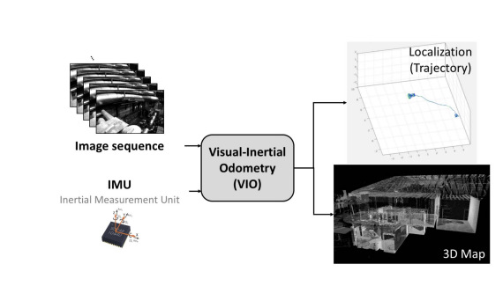
Introduction
Motivation for this project arises from the challenges in accurately initializing a visual-inertial odometry (VIO) system.
What is a VIO?
The importance of VIO for autonomous navigation and mapping.
Challenges in existing technologies: accuracy-real-time balance, adaptability in dynamic environments, computational constraints.

Slide 3
DM-VIO:
Delayed Marginalization and Pose Graph Bundle Adjustment
stem:
Delayed Marginalization and Pose Graph Bundle Adjustment
Delayed Marginalization: Overcomes limitations of traditional marginalization by allowing relinearization and integration of IMU information post-initialization.
Advantages: Maintains the full photometric probability distribution, allowing for updates with IMU data and relinearization of variables within the Markov blanket.
Execution: Performs marginalization with a delay, keeping a second delayed marginalization prior alongside the main graph, which is crucial for quick updates and retaining information.
Pose Graph Bundle Adjustment (PGBA): Utilizes the delayed graph populated with IMU factors for an optimized initialization, balancing accuracy and processing speed.
Optimization Process: Leverages the GTSAM library for efficient optimization, avoiding full BA's computational load while achieving superior accuracy over PGO.

Slide 4
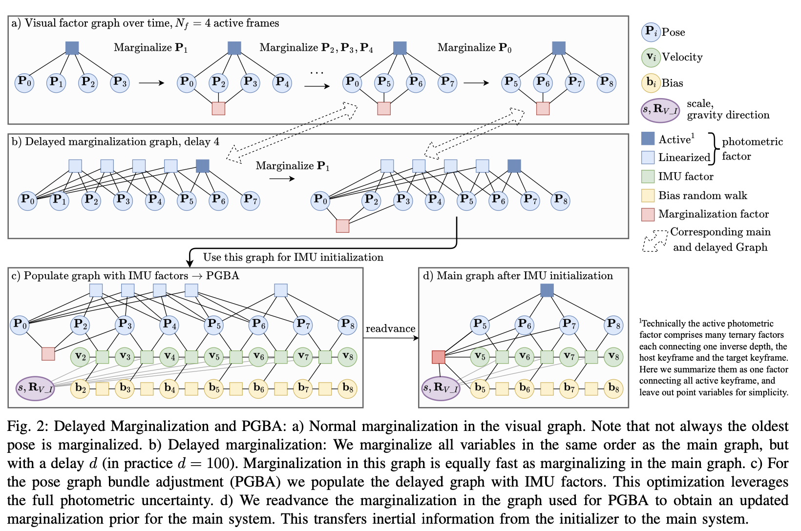

Slide 5
Technical Details
stem:
Delayed Marginalization and Pose Graph Bundle Adjustment
Photometric bundle adjustment: handling image features and optimization for dynamic visual tracking.
IMU Initialization: novel approaches to initializing the system using IMU data, enhancing the scale and pose estimation.

Slide 6
Experimental Results and Evaluation
stem:
Delayed Marginalization and Pose Graph Bundle Adjustment
EuRoC Dataset Performance: Demonstrated significant improvement over state-of-the-art mono and stereo VIO systems.
TUM-VI Dataset Success: Outperformed state-of-the-art stereo-inertial methods, showcasing the robustness of DM-VIO.
4Seasons Dataset: Achieved strong performance in automotive scenarios, surpassing stereo-inertial methods with monocular setup​​​​.
Notable Achievements: Not only did DM-VIO excel in traditional metrics but also showed the lowest average scale error.
Challenges Overcome: Handled stretches of constant velocity which are typically hard for monocular methods, thanks to the novel IMU initializer.

Slide 7
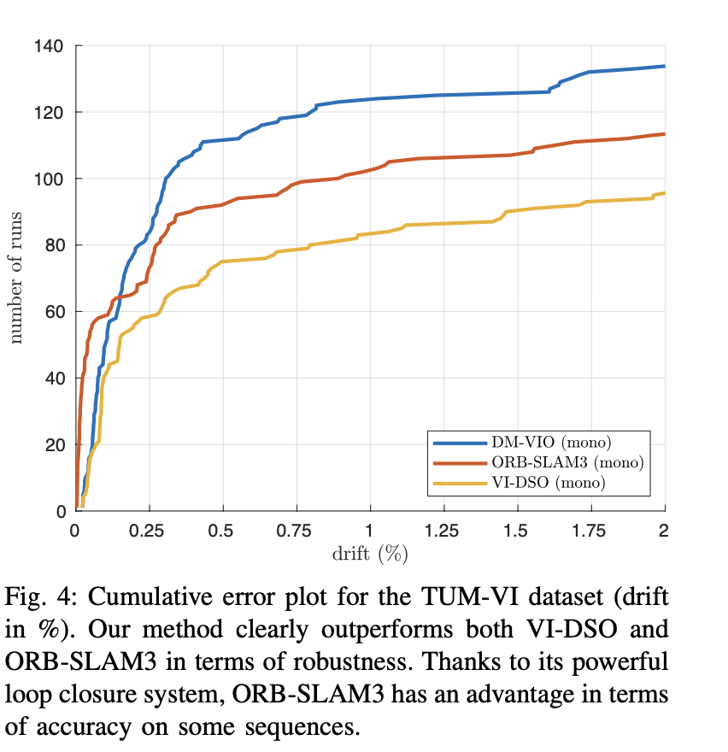
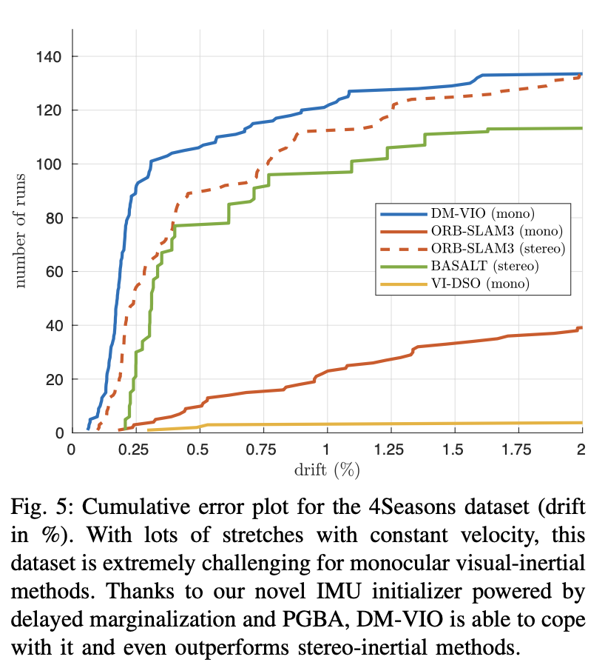

Slide 8
Conclusion and Future Work
stem:
Delayed Marginalization and Pose Graph Bundle Adjustment
A substantial advancement in visual-inertial odometry.
Enhances the performance of monocular VIO
Sets the stage for future research directions.
Potential applications.

Slide 9
Related Works
Stereo visual inertial pose estimation based on feedforward-feedback loops (Secondary paper).
Traditional VIO approaches: brief historical context and developments.
The role of deep learning in VIO (if mentioned): a summary of how deep learning has been integrated into VIO systems to enhance performance.
A multi-state constraint Kalman filter for vision-aided inertial navigation, A. I. Mourikis and S. I. Roumeliotis, in ICRA, 2007.

Slide 10
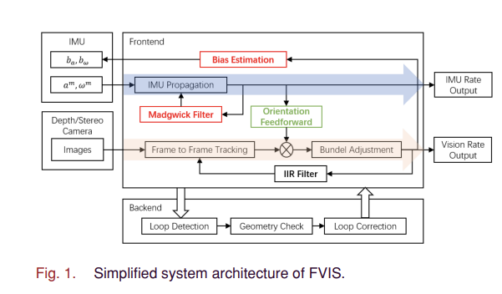
Stereo visual inertial pose estimation based on feedforward-feedback loops
Motivation: Addressing the need for accurate visual-inertial fusion for UAV navigation, particularly on systems with limited computational resources. The goal is to improve the accuracy of pose estimation without increasing computational demand​​.
Main Contributions: The paper introduces FVIS, which models stereo visual inertial pose estimation from a control perspective, employing feedback and feedforward loops for sensor fusion. The feedforward part is using the pose prediction provided by IMU data to assist visual data processing. Feedbacks include using the differences of visual estimation and IMU prediction feedback to adjust the processing of the IMU data to correct for the bias in pose estimation.

Slide 11
Stereo visual inertial pose estimation based on feedforward-feedback loops
Common Field and Purpose: Both papers contribute to the advancement of VIO systems, which are pivotal for applications in robotics, autonomous navigation, and augmented reality. Each paper proposes a different methodology to overcome the challenges associated with VIO, such as scale estimation, robustness, and computational efficiency.
Technical Innovations: "DM-VIO" introduces delayed marginalization and pose graph bundle adjustment in a monocular setup, whereas the "Stereo Visual Inertial Pose Estimation" paper presents a stereo-based system with a novel feedforward-feedback control system approach.

Slide 12
Milestones:
Reproduce the result of the Primary paper –-—-- Nov 13 - Nov 24
Reproduce the result of the Secondary paper –-—-- Nov 25 - Nov 30
Carry out hands-on, practical experiments with UAVs. –-—-- Dec 1 - Dec 9
Combine the methods and evaluate the performance comparisons –-—-- Dec 10 - Dec 18
Analyze the result and prepare for the final presentation –-—-- Dec 19 - Dec 21

Slide 13
Questions?

Slide 14
Thank you!

